Slide 1
ALY 6010 Analyzing Factors Affecting Airbnb Listings in Hawaii FINAL PROJECT
By
Nithin Reddy Penta Reddy

Slide 2
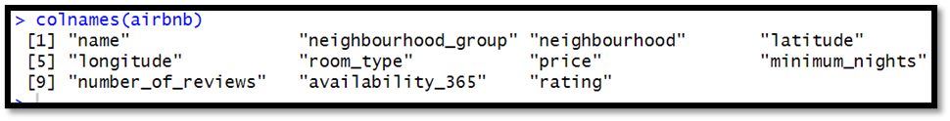
INTRODUCING THE DATASET
After reading the dataset, adjusted it to only include the focus variables
Further cleaned the data using built-in functions
Removed NA values

Slide 3
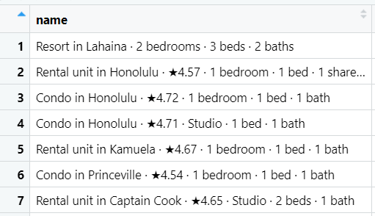
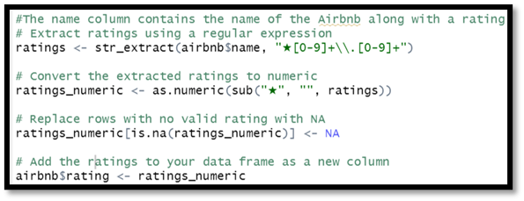
DATA CLEANING
We found the name column to contain the rating for that particular Airbnb
Using regular expressions extracted the ratings which was in a string datatype
If a rating was missing, NA was designated to it

Slide 4
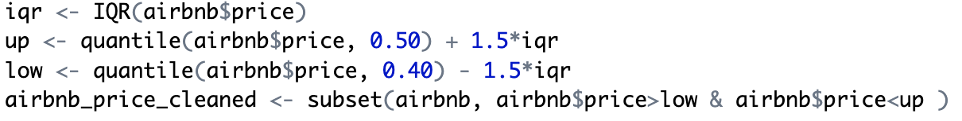
DATA CLEANING
Clearing outliers for better analysis and visualizations
Used 50% and 40% to calculate the lower bound and upper bound of the price to clear outliers, as the data contains a lot of them and they are hampering the analysis.

Slide 5
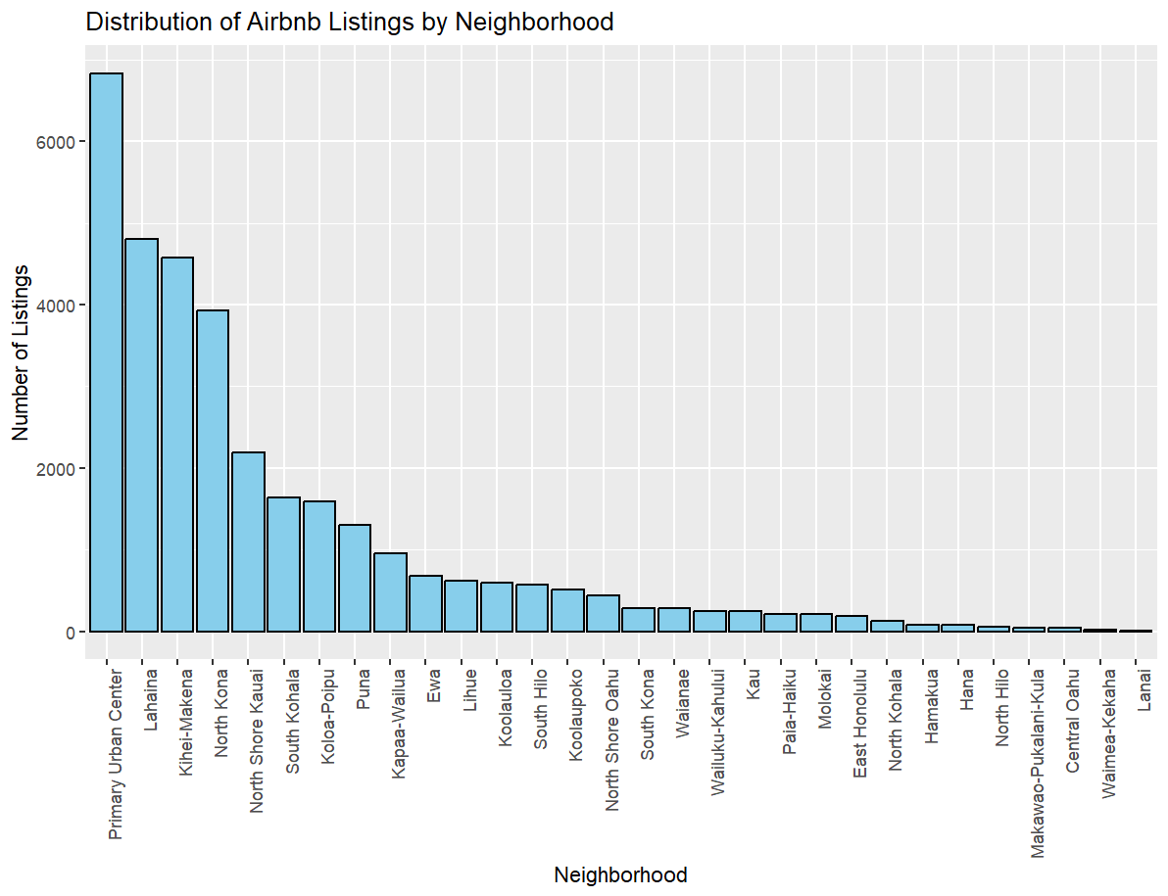
DATA VISUALIZATION
Bar plot shows the distribution of Airbnb based on the number of listings per neighbourhood

Slide 6
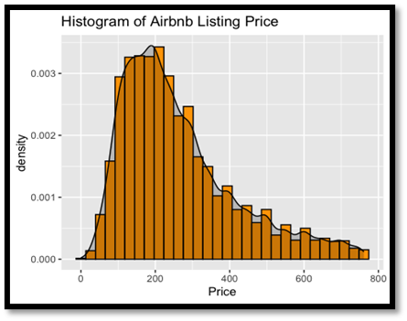
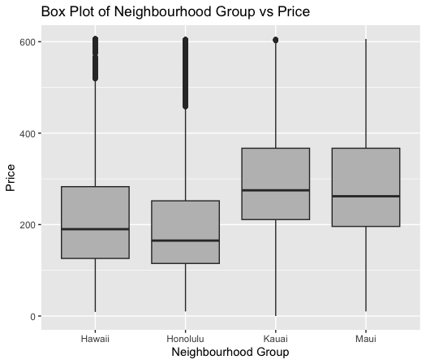
DATA VISUALIZATION
Histogram shows price with density
Closely packed Box plot with no outliers

Slide 7
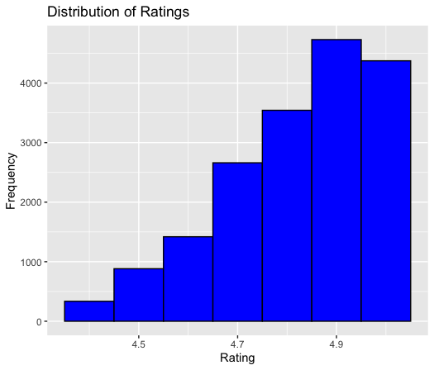
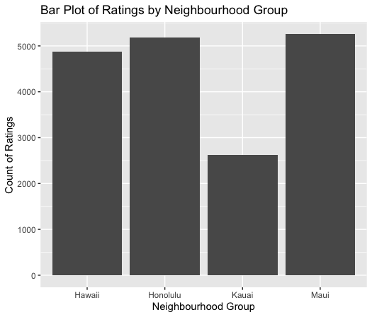
DATA VISUALIZATION
Visualized the newly created column ‘Ratings’ as a histogram & Neighbourhoods

Slide 8
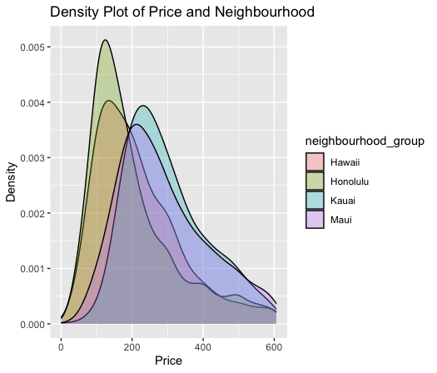
DATA VISUALIZATION
Density plot of Price vs Neighbourhood shows Hawaii has the tightest distribution

Slide 9

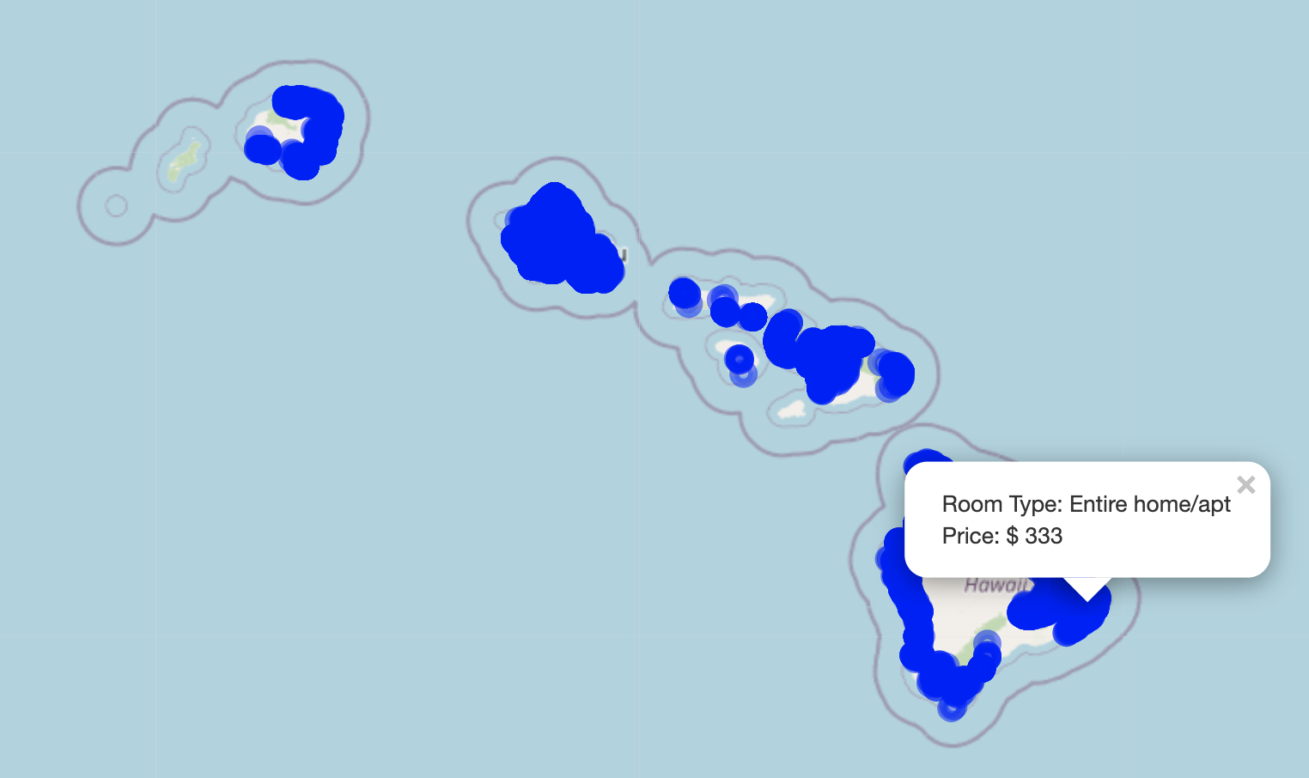
ADDITIONAL FEATURE: LEAFLET MAP
Maps in R are embedded with great features. We used LEAFLET MAP feature to create a map where the user can scroll through the map and If we select a place, it would pop out the price and type of accommodation. Here is an example.

Slide 10
EXPLORING THE DATA WITH QUESTIONS
Q1. Do Airbnb listings in specific neighborhoods differ significantly in their average price?
#H0: There is no significant difference in the average prices between neighborhoods North Kona and Primary Urban Center
#H1: There is a significant difference in the average prices between neighborhoods North Kona and Primary Urban Center

Slide 11
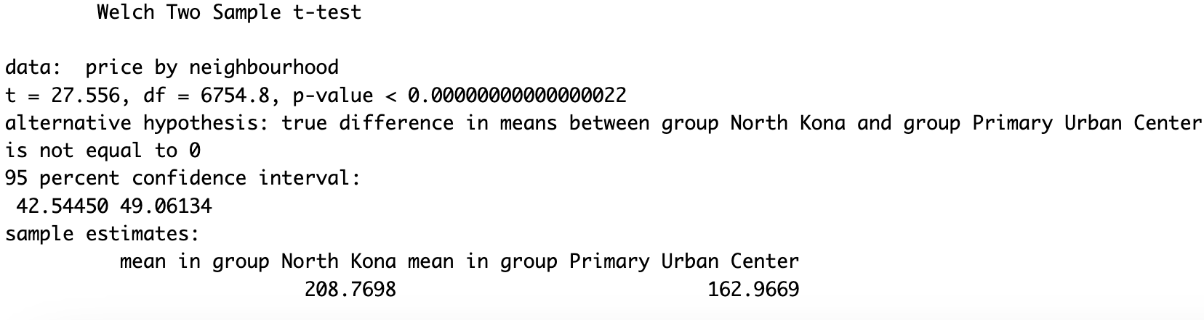
Q1. Do Airbnb listings in North Kona and Primary Urban Center neighborhoods differ significantly in their average price?
The p-value being being very low it indicates there is a strong evidence to reject the null hypothesis. It suggests that there is a significant difference in mean prices between North Kona and Primary Urban Center

Slide 12
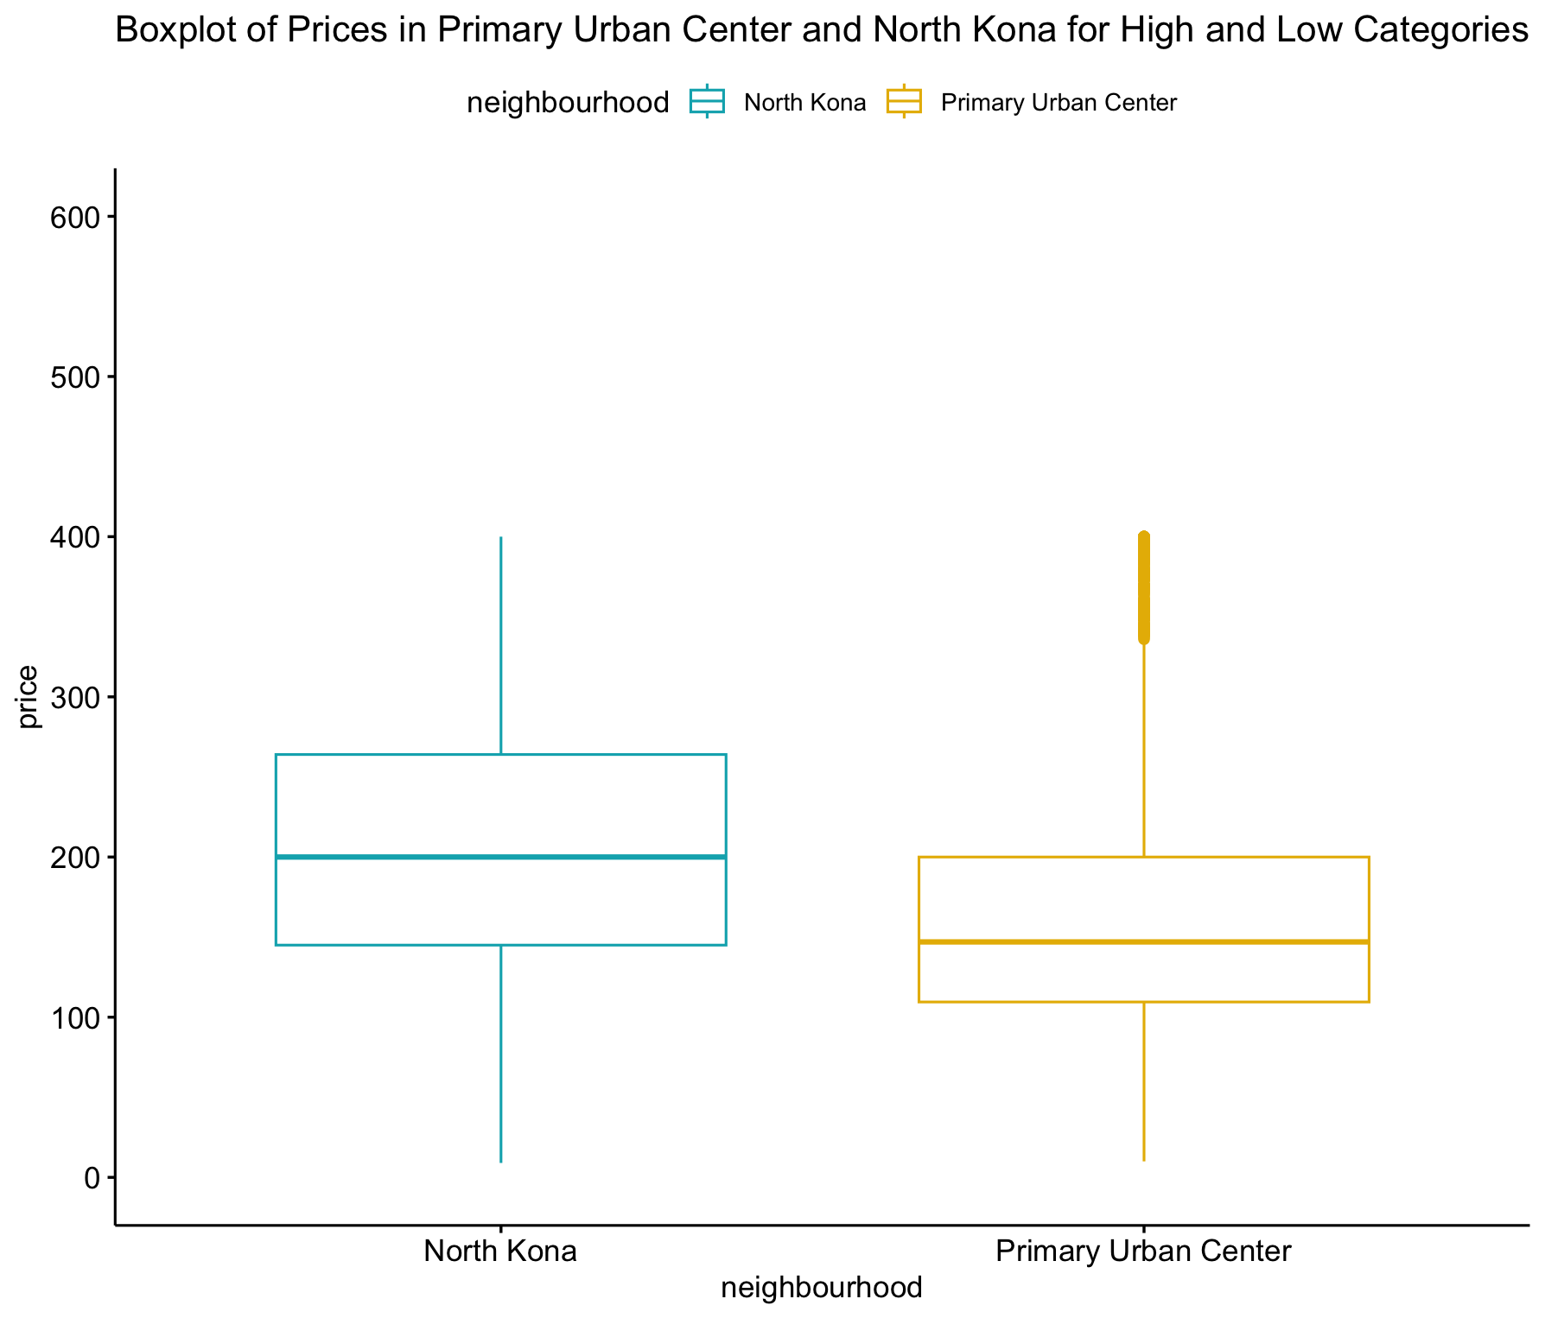
Q1. Do Airbnb listings in North Kona and Primary Urban Center neighborhoods differ significantly in their average price?
Visualized the result of the t-test as a box plot
Used nighbourhood_group as data to access the of neighbourhoods " North Kona and Primary Urban Center and adjusted the y_lim as per available price points.

Slide 13
EXPLORING THE DATA WITH QUESTIONS
Q2. Is there a significant difference in average price between listings with high and low ratings?
Null Hypothesis (H0): The average prices between high and low-rated listings are the same.
Alternative Hypothesis (H1): There exists a statistically significant difference in average prices between high and low-rated listings.

Slide 14
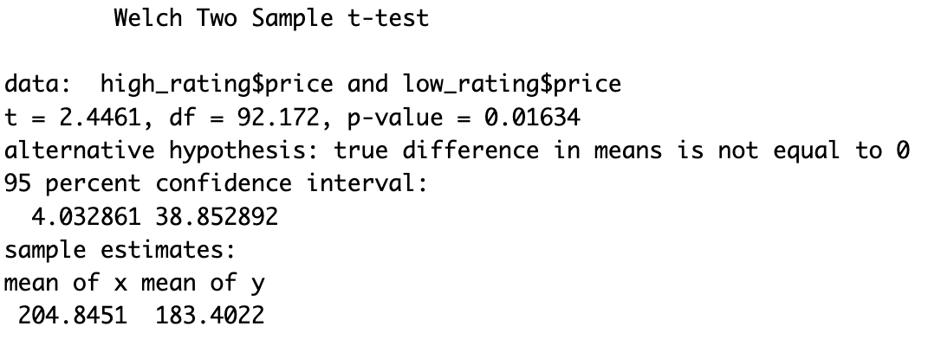
Q2. Is there a significant difference in average price between listings with high and low ratings?
The p-value (0.016) is less than the commonly used significance level of 0.05. Therefore, there is no strong evidence to reject null hypothesis

Slide 15
EXPLORING THE DATA WITH QUESTIONS
Q3. Does shorter distance between properties and center of Hawaii have any effect on pricing?
Null Hypothesis (H0): There is no significant difference in mean pricing between properties within 30 km and those beyond
Alternate Hypothesis (H1): There is a significant difference in mean pricing between properties within 30 km and those beyond

Slide 16
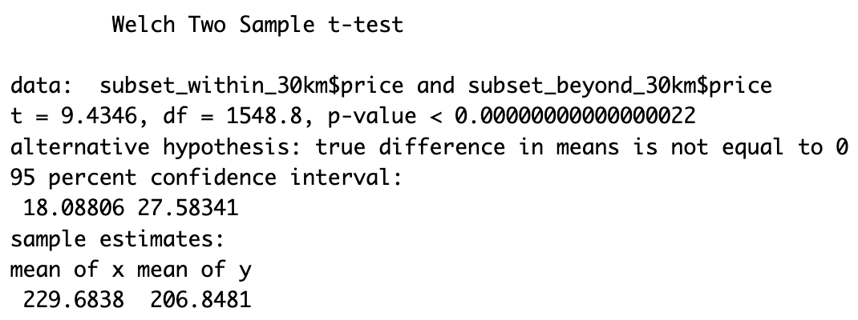
EXPLORING THE DATA WITH QUESTIONS
Q3. Does shorter distance between properties and center of Hawaii have any effect on pricing?
The p-value is less than the commonly used significance level of 0.05, indicating strong evidence against the null hypothesis.

Slide 17
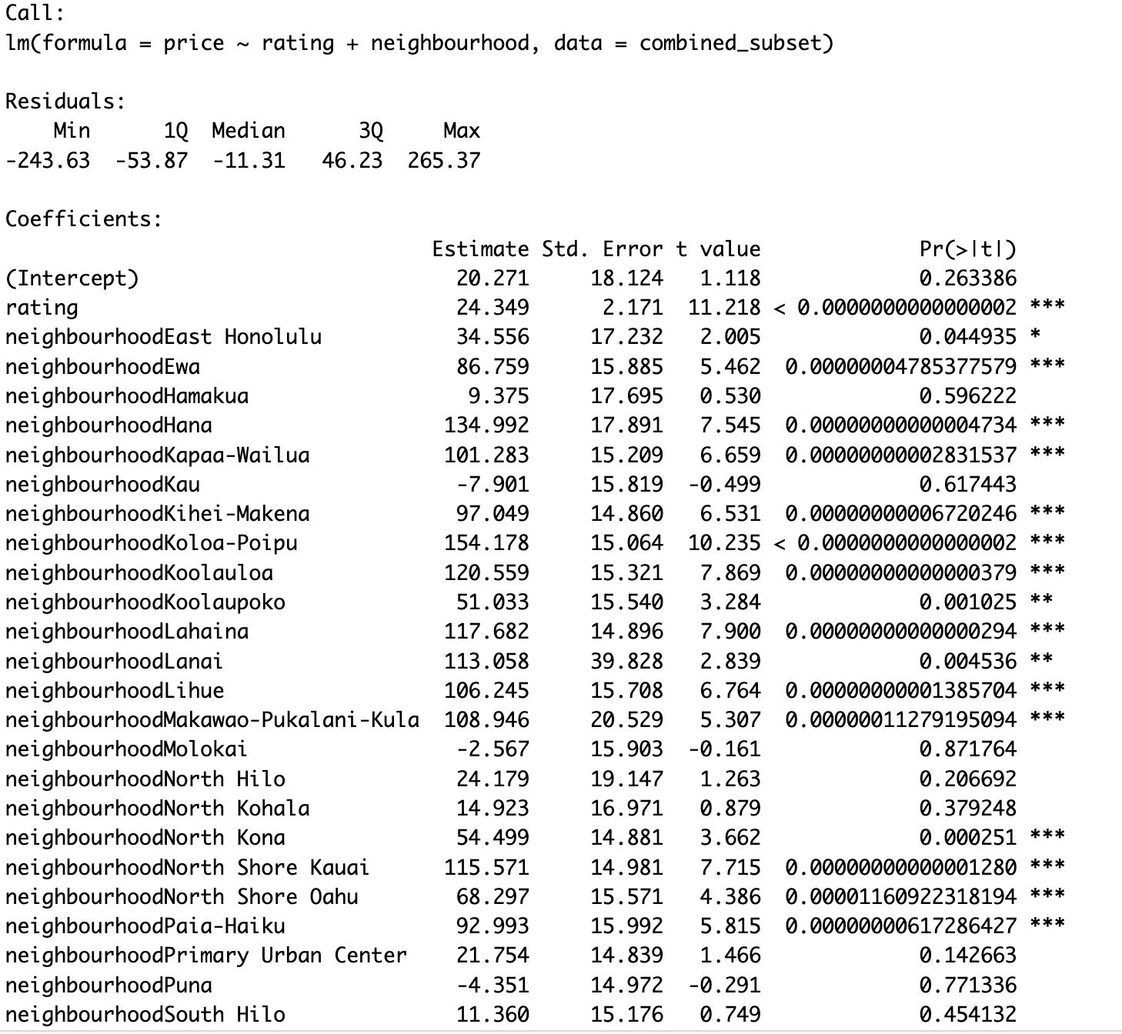
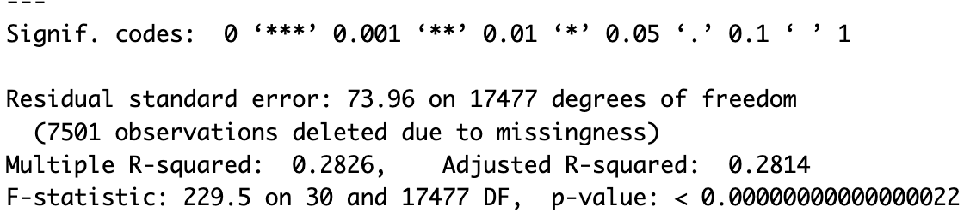
REGRESSIONAL ANALYSIS
Question 1
Does Ratings and Neighbourhood effect the pricing
Key Finding:
This model shows a significant evidence that the different different ratings and neighborhood can predict prices to an extant
The model's R-squared 28.26%, indicating that the neighborhood and ratings cab be good predictors of price variations

Slide 18
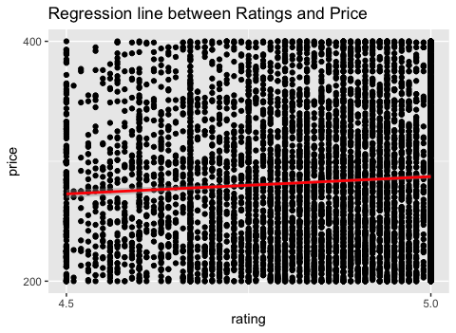
REGRESSIONAL ANALYSIS
Utilized ggplot to illustrate the relationship between price and rating with a regression line.
The chart demonstrates the trend that as ratings increase the prices increases, as suggested by the red regression line.

Slide 19
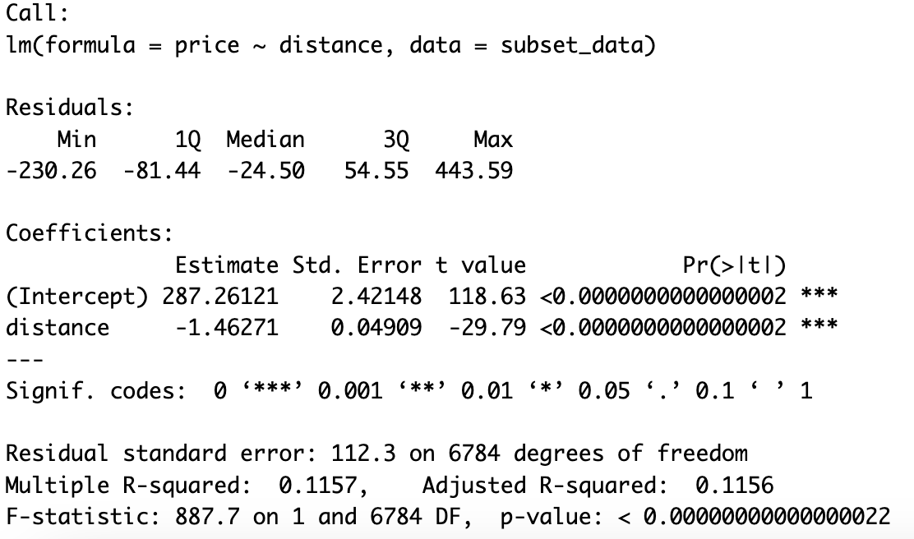
REGRESSIONAL ANALYSIS
Question 2
Conducted a linear regression (lm()) analysis using price as the dependent variable and distance as the predictor within the Airbnb dataset.
Key Findings:
The model indicates that there is a statistically significant positive relationship between 'rating' and 'price’..
The R-squared is about 11.5%, suggesting that 'rating’ contribute towards the price variation in Airbnb listings, however there are other variables that effect the price

Slide 20
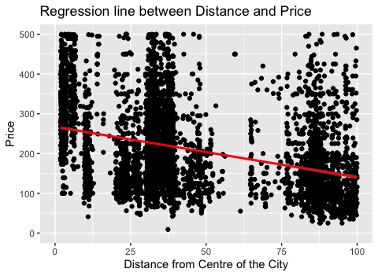
REGRESSIONAL ANALYSIS
Revisiting question 2
Utilized ggplot to illustrate the relationship between price and rating with a regression line.
The chart demonstrates the trend that higher distance increases the prices in the dataset decreases accordingly, as suggested by the red regression line.

Slide 21
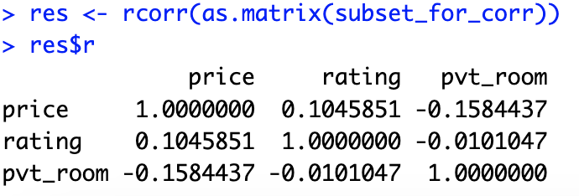
REGRESSIONAL ANALYSIS
Revisiting question 3
Correlation Analysis :
Employed `rcorr` from the `Hmisc` library
to compute the correlation matrix.
Price & Rating: There's a weak positive correlation (0.1046) between 'price' and 'rating'. This suggests a slight positive relationship between the price of properties and their ratings. However, the correlation is not strong.
Price & Private Room: There's a moderate negative correlation (-0.1584) between 'price' and 'pvt_room'. This indicates that there's a moderate negative relationship between the price of properties and the presence of a private room. As the price increases, the likelihood of it being a private room decreases to a moderate extent.
Rating & Private Room: There's a very weak negative correlation (-0.0101) between 'rating' and 'pvt_room'. This suggests a minimal negative relationship between the rating of properties and the presence of a private room. The correlation is nearly negligible.
Notes:
A nonlinear relationship, or nonlinear association, exists when a constant change in the independent variable does not cause a constant change in the dependent variable

Slide 22
CONCLUSION
In this project our main aim was to check whether Price has any association with Neighbourhood Group, Ratings and Distance.
Through T-test:
Based on P-value :
We found there there is a significant difference in the average prices between North Kona and Primary Urban Center.
There was a strong evidence to reject null hypothesis which suggests that there is no significant difference in mean prices of high and low rating groups
The shorter distance between properties and center of Hawaii has no effect on pricing, we have p-value which is less than the commonly used significance level of 0.05, indicating strong evidence against the null hypothesis.

Slide 23
CONCLUSION
Through Regression we tried to predict the outcome and test the significance as well as the strength of the relation between independent and dependant variables.
In both the cases we have observed that the independent variables are predicting the price. However, the predictors of price suggest that there are other factors which would influence Airbnb pricing in these neighborhoods beyond, ratings and distance.

Slide 24
THANK YOU!! Questions?

